Slide 1
Power BI Training
Pavan Mani Deep Y
Deriving Insights with Power BI Powerful alone. Better Together with Data

Slide 2


Pavan Mani Deep Y
Your host is Microsoft MVP, a passionate Power Platform, Power BI Consultant
Blog: https://ecellorscrm.com
LinkedIn: https://www.linkedin.com/in/pavanmanideep/
Twitter: https://twitter.com/EcellorsCrm
LinkedIn

Slide 3
Prerequisites for working on Power BI
Power BI desktop understanding – To develop the reports
License for Power BI to publish and a workspace to share reports with other users
Data Analysis, Data Modelling Skill
Business Understanding

Slide 4

Join the Power BI Learning Hub WhatsApp Channel
‎

Slide 5
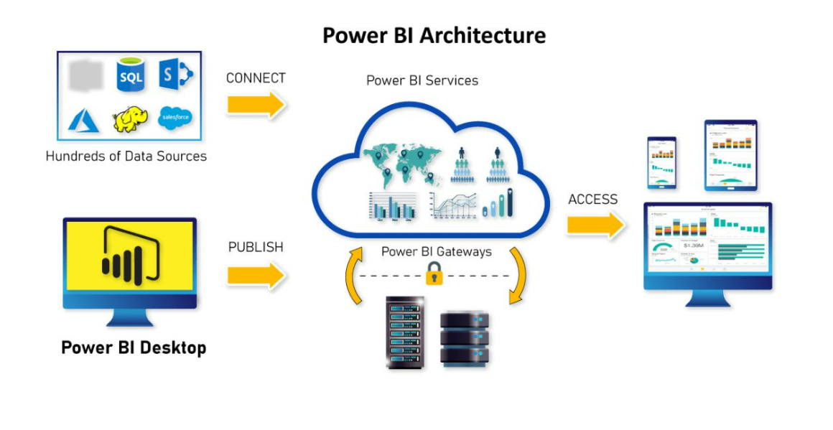
Components
Power BI Reports
Power BI Dashboards
Semantic Model
Power BI Dataflows
Power BI Report Server

Slide 6
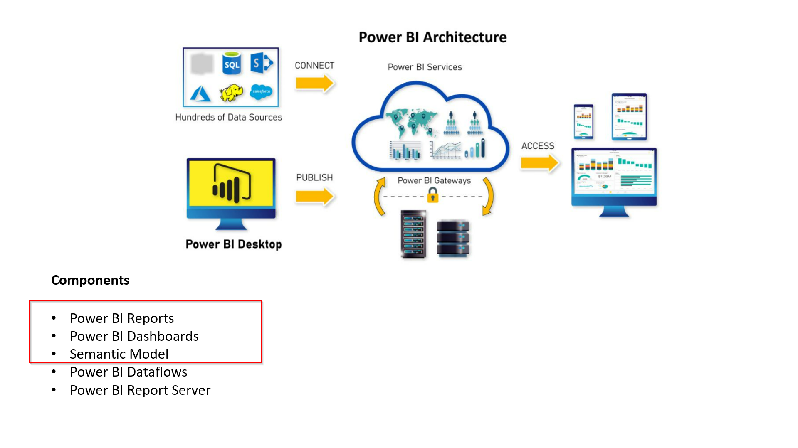

Slide 7
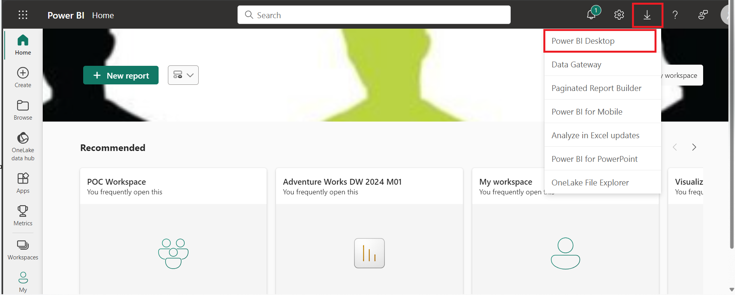
Installing Power BI Desktop
Developing Reports
Two ways to get it
Download the Power BI Desktop exe file
Download from Microsoft Store – Preferred

Slide 8

Steps involved in creating Power BI Reports/Dashboards
Getting Data from data source
Cleaning the Data
Model the data
Visualize the Data
Publish the Report to Power BI Service
Sharing the Report
Create dashboards by pining the visuals

Slide 9
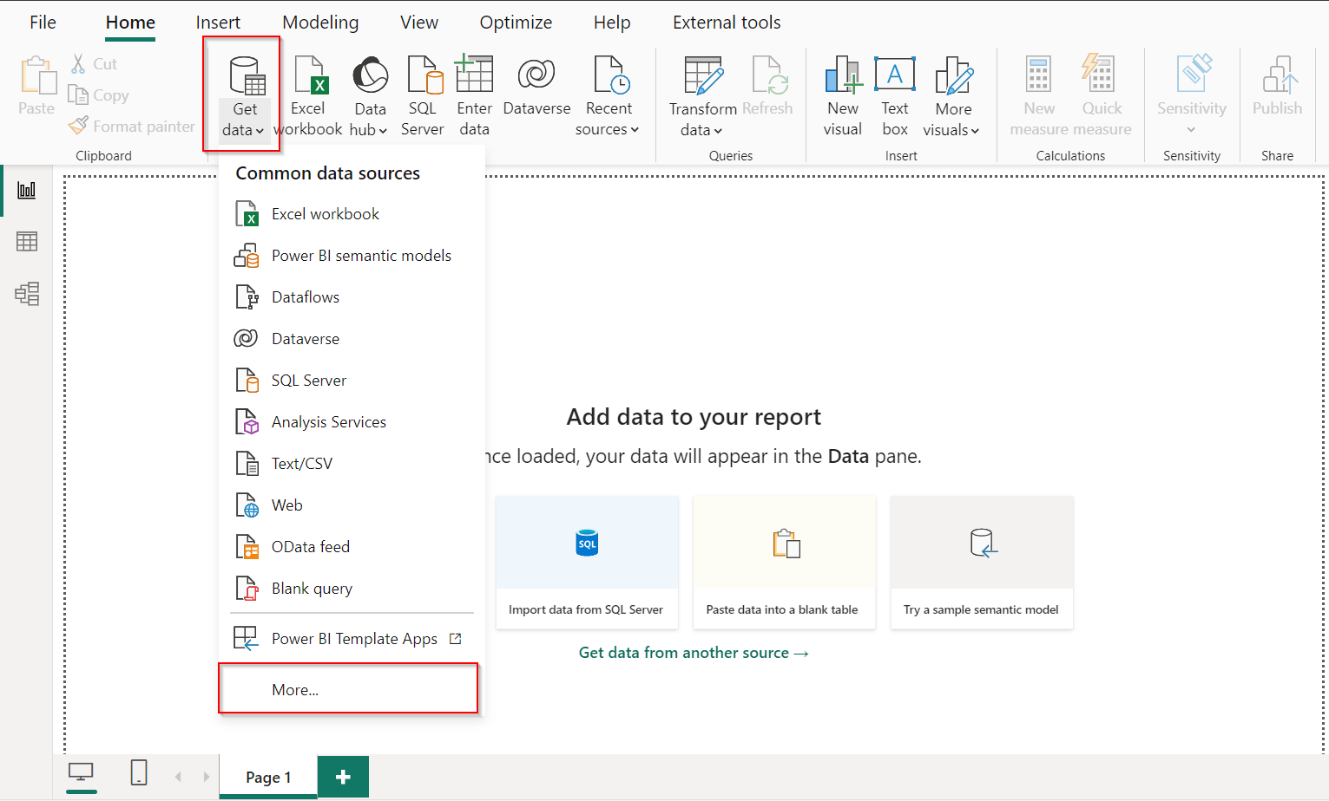
Connecting Data source
Ways to connect to the different connectors available in Power BI
There are 120 + data sources available from which you can choose from

Slide 10
Choosing import modes
Import Mode
Direct Query
Data is imported into Power BI and preferred mode in most scenarios
Stores a snapshot of data in the report, which can be refreshed at scheduled intervals.
Data is the source is not modified with any ETL operations
Faster performance as it used Vertipaq storage engines
Do note the data volume limitations for import
Allows users to directly query data from a connected data source
It is best suited for Real Time Analytics
Data in the source is modified with any ETL operations
Slower performance when compared and mainly depends on the underlying data source
A limit of 1 million rows can be returned in any query
Live Connection connects to the reports using Semantic Model
Lastly choosing import mode may depend on business needs and you can combine both making Dual Mode

Slide 11
Data preparation and modelling
Once data is loaded in to PBI, necessary ETL transformations are performed using Power Query
Create relationships between tables
Star Schema design principle
Creating Measures
Calculated Column
Calculated table

Slide 12
Understanding the Relationships
Relationships play a crucial role in any model design
Power BI attempts to identify the relationships when data is loaded
Relationships can be manged from Manage Relationships in Power BI Desktop
Cardinality and cross filter direction play an important role in filtering your dataset.

Slide 13
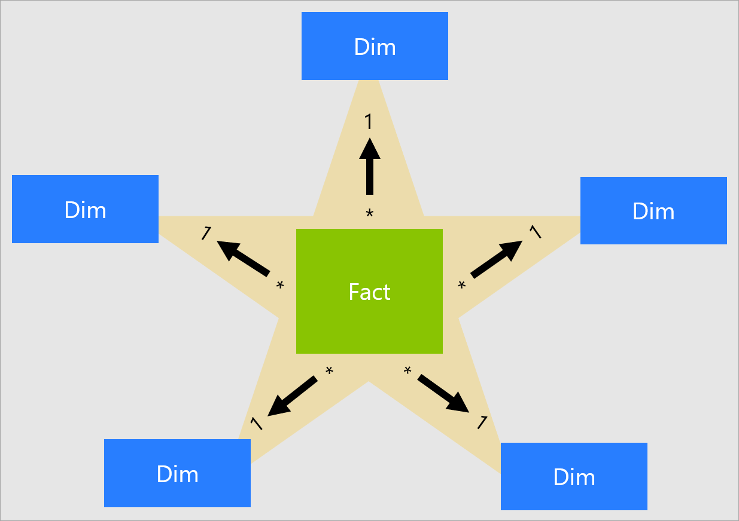
Star Schema Design
Star schema requires model tables to be classified as Fact and Dimension tables
It is only determined by the Relationships
1. Dimension tables support filtering and grouping
2. Fact tables support summarization
Star Schema Models are optimized for performance and usability

Slide 14
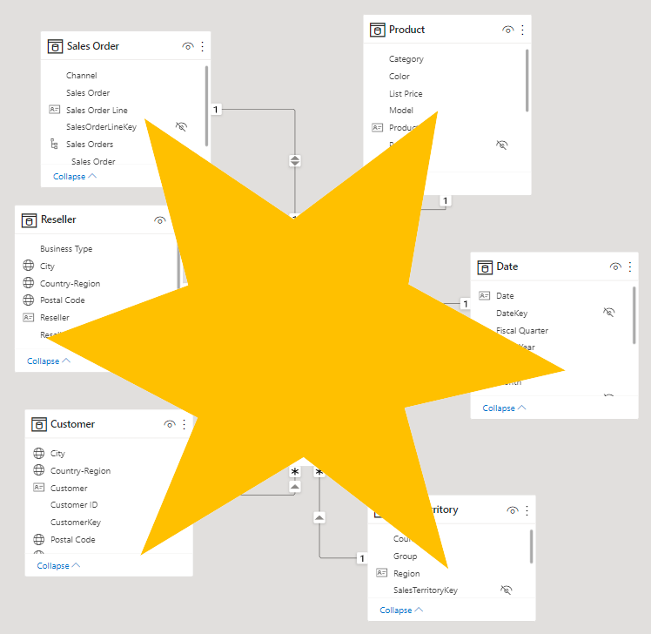
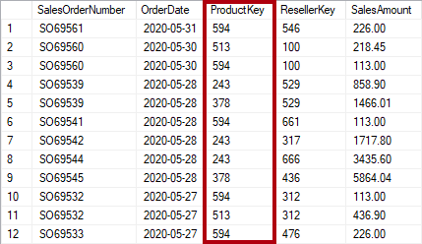
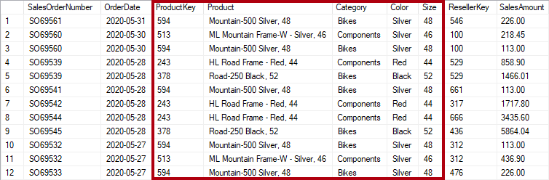
Normalization
Denormalization

Slide 15
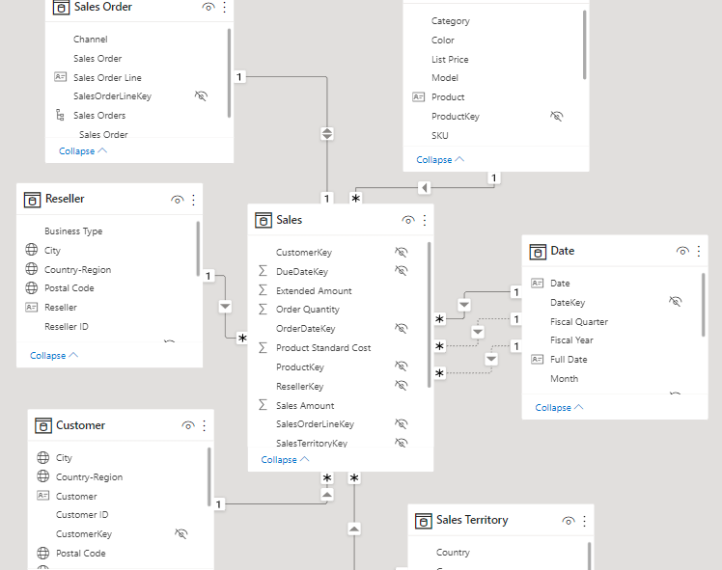
Modelling for high performance scenarios
Model should consists of Fact and Dimension tables
Remove Unnecessary Columns
Remove Unnecessary Rows
Disable Auto Date Time
Disable Power Query Load

Slide 16
Modelling continued..
DAX(Data Analysis Expressions)
Blue Revenue =
CALCULATE(
SUM(Sales[Sales Amount]),
'Product'[Color] = "Blue"
)
Syntax
Functions
Context
1. Row Context - Calculated Column – Precomputed and stored in the model
2. Filter Context – Measure – Not precomputed and stored in the model
Formulate your DAX code using DAX Guide(https://dax.guide/generate/)
Debug your DAX code in DAX Studio(https://daxstudio.org/)
Using Power Query for any ETL transformations on source data
Understanding difference between M Query and DAX

Slide 17
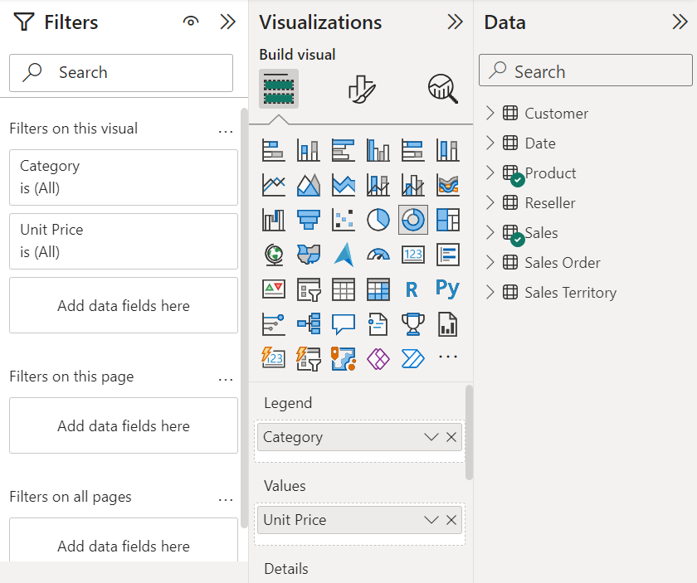
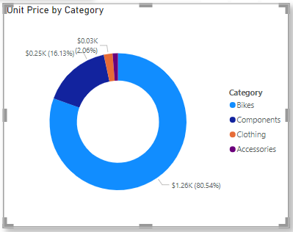
Creating visualizations
Select the required visualization as per your requirement
Drag the data fields on to the visual

Slide 18

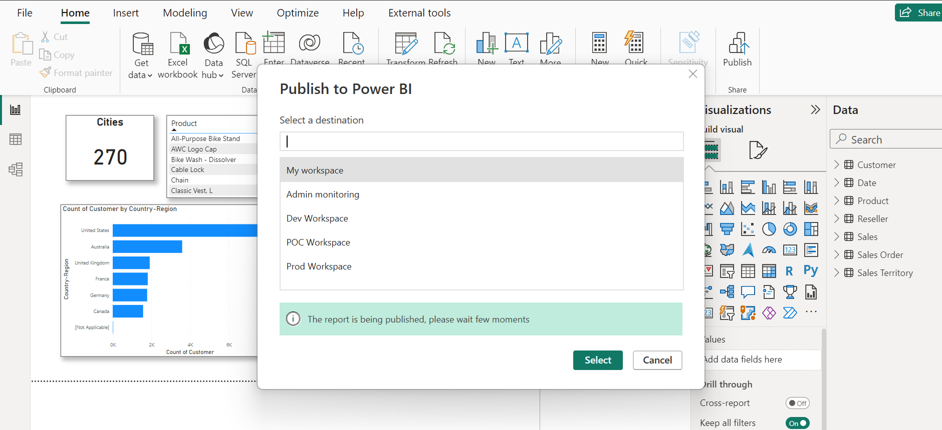
Publish to Power BI Service
Setting up workspaces to manage different environments
One click publish to Power BI Workspace
Set up Refresh frequency in Power BI Service

Slide 19
Tools to use for development
DAX Studio https://daxstudio.org/downloads/ - Best tool to use
DAX Formatter https://www.daxformatter.com/ - formats DAX code
DAX Guide https://dax.guide/
Power BI Helper https://powerbihelper.org/ - tool to create documentation for the Power BI
ALM Tool Kit (http://alm-toolkit.com/)- manages the application life cycle of models
Bravo (https://www.sqlbi.com/tools/bravo-for-power-bi/) – used for simple Power BI Tasks

Slide 20
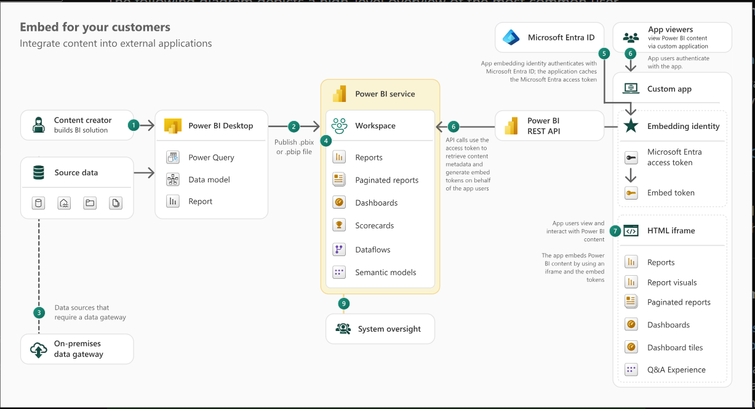
Understanding Power BI Embedded
Check out Power BI Embedded Analytics Playground https://playground.powerbi.com/en-us/

Slide 21
Integration and extensibility with Power Apps
Model Driven Apps
a. Power BI Embed Reports with Environment variables
b. Embed Power BI Report in Model driven App forms
2. Canvas Apps
a. Insert Custom Power BI Tiles and Power BI Report
b. Power Apps visual for Power BI

Slide 22
Options in Power BI Security in Power BI
In Power BI Desktop
Data Load
Authentication in Browser
In Power BI Service
Manage access to workspace
Sharing the Power BI Reports/Dashboards
In Admin Centre
Tenant Settings
Custom branding
Usage Metrics
Organization Visuals
Connecting to Azure
Row Level Security – Applies for Viewers only
Object Level Security – Secure specific tables or columns for certain viewers
Licensing in Power BI
Free
Power BI Pro
Power BI Premium Per User
Power BI Premium(P SKU)
Power BI Embedded(A SKU)

Slide 23
Demo

Slide 24

Corporate Spend

Slide 25

singapure

Slide 26

Q & A

